Slide 1
Counters
Reference
Chapter 7
Registers and Register Transfers
Moris Mano 4th Edition

Slide 2
Counter
A register that goes through a prescribed sequence of distinct states upon the application of a sequence of input pulses
Input pulses may be
Clock pulses
Originate from some other source
May occur at regular or irregular interval of time

Slide 3
Binary Counter
Counter that follows the binary number sequence is called binary counter
An n-bit binary counter consists of n flip-flops and can count in binary from 0 through 2^{n}-1

Slide 4
Types of Counters
Asynchronous Counters
In which C input of some of the flip-flops are triggered not by common pulse but rather by the transitions that occur on other flip-flop outputs
e.g. Ripple counters
Synchronous Counters
In which the C inputs of all flip-flops receive common pulse

Slide 5
Asynchronous Counters

Slide 6
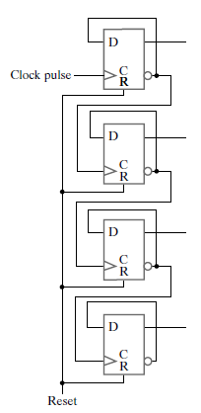
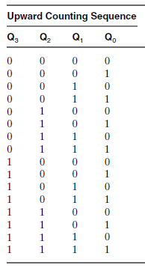
4-bit Ripple Counter
What will be the state of counter on positive edge after 1111?

Slide 7
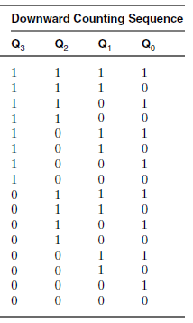
4-bit Ripple Counter
Design a 4-bit ripple counter for downward counting
Can you design an asynchronous Up-Down
Counter with Selection Input?

Slide 8
Synchronous Counters

Slide 9
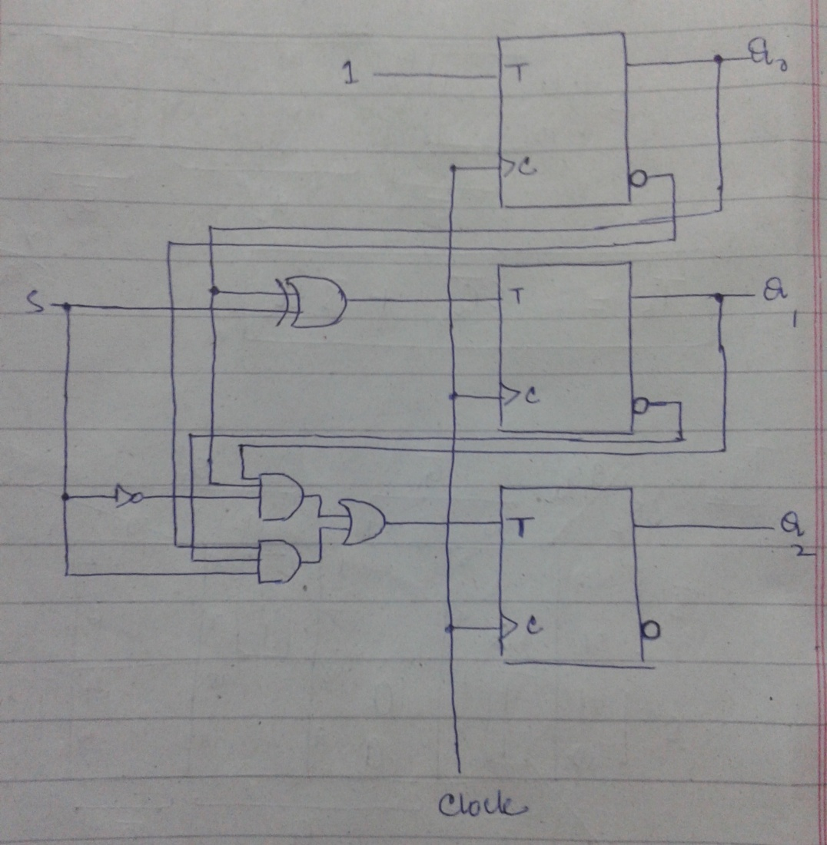
Synchronous 3-bit Up-Down Counter
For S=0
Count Upward
For S=1
Count Downward

Slide 10
Synchronous 3-bit Up-Down Counter
For S=0 ➔ Count Upward
For S=1 ➔ Count Downward
FF A
FF B
FF C

Slide 11
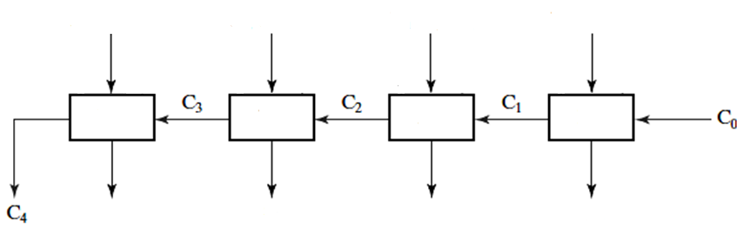
Serial Counter
Q3(t)
Q2(t)
Q1(t)
Q0(t)
EN
HA
HA
HA
HA
Q3(t+1)
Q2(t+1)
Q1(t+1)
Q0(t+1)

Slide 12
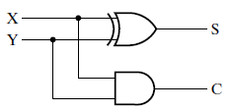
Half Adder

Slide 13
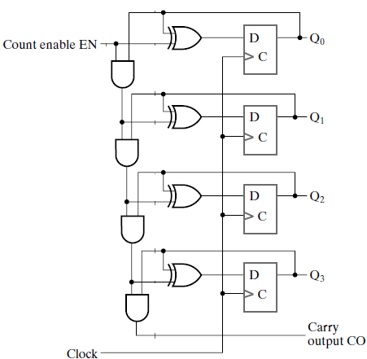
Serial Counter
Notes:
4-Bit Synchronous Binary Counter with Serial Gating. Page 360 – Moris Mano 4th Edition

Slide 14
Serial Counter
Half Adders

Slide 15
Serial Counter
S0
C1
S1
C2
S2
C3
S3
C4

Slide 16
Serial Counter
If EN = 0, Hold Data
If EN = 1, Increment by 1

Slide 17
How Serial Counter Works?
1
0
1
0
0
Value at time t = 0010
What will be the value at time t+1

Slide 18
How Serial Counter Works?
0
1
1
0
0
Qi outputs coming to
XORs and ANDs

Slide 19
How Serial Counter Works?
0
1
1
1
0
0
0

Slide 20
How Serial Counter Works?
0
1
1
1
0
1
0
0
0

Slide 21
How Serial Counter Works?
0
1
1
1
0
1
0
0
0
0
0

Slide 22
How Serial Counter Works?
0
1
1
1
0
1
0
0
0
0
0
0
0

Slide 23
How Serial Counter Works?
0
1
1
1
0
1
0
0
0
Value of this AND depends
On three ANDs in previous
Levels of gating
0
0
0
0

Slide 24
How Serial Counter Works?
0
1
1
1
0
1
0
0
0
0
0
0
This data will be
available at next tick
0

Slide 25
How Serial Counter Works?
1
1
1
0
0

Slide 26
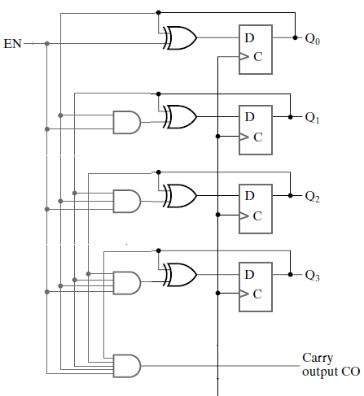
Parallel Counter
Clock
Notes:
4-Bit Synchronous Binary Counter with Parallel Gating. Reference: Page 360 Moris Mano 4th Edition

Slide 27
How Parallel Counter works?
1
0
1
0
0
Value at time t = 0010
What will be the value at time t+1
Clock
Notes:
4-Bit Synchronous Binary Counter with Parallel Gating. Reference: Page 360 Moris Mano 4th Edition

Slide 28
How Parallel Counter works?
1
0
1
0
0
Clock
Notes:
4-Bit Synchronous Binary Counter with Parallel Gating. Reference: Page 360 Moris Mano 4th Edition

Slide 29
How Parallel Counter works?
1
0
1
1
0
0
This signal 0 is coming from Q0
0
0
0
0
Clock
Notes:
4-Bit Synchronous Binary Counter with Parallel Gating. Reference: Page 360 Moris Mano 4th Edition

Slide 30
How Parallel Counter works?
1
0
1
1
0
0
All the ANDs which got 0
Gave output 0
0
0
0
0
Clock
Notes:
4-Bit Synchronous Binary Counter with Parallel Gating. Reference: Page 360 Moris Mano 4th Edition

Slide 31
How Parallel Counter works?
1
1
1
0
X XOR 1 = X’
X XOR 0 = X
0
0
Clock
Notes:
4-Bit Synchronous Binary Counter with Parallel Gating. Reference: Page 360 Moris Mano 4th Edition

Slide 32
How Parallel Counter works?
1
1
1
0
This data will be available
On counter output at time t+1
0
0
Clock
Notes:
4-Bit Synchronous Binary Counter with Parallel Gating. Reference: Page 360 Moris Mano 4th Edition

Slide 33
How Parallel Counter works?
1
1
1
0
Counter at time t+1
0
0
Clock
Notes:
4-Bit Synchronous Binary Counter with Parallel Gating. Reference: Page 360 Moris Mano 4th Edition

Slide 34
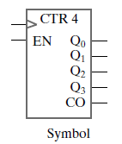
4-Bit Synchronous Binary Counter

Slide 35
Serial VS Parallel Counter
Clock
Gate delay being accumulated in Serial Counter as last AND is at level 4 of gating.
For example, going from state 1111 to state 0000.

Slide 36
Serial VS Parallel Counter
Clock
Output of 4th AND gate depends on the outputs of all previous AND gates.
i.e. Delay of four AND Gates being accumulated.

Slide 37
Practice Problems
1. Arbitrary Count Sequence: Design a synchronous counter which follows sequence given below:
0, 2, 4, 6, 8, 0, 2,…
2. BCD Counter: Design a BCD synchronous counter which follows the sequence given below:
0,1,2,3,4,5,6,7,8,9,0,1,2,…

Slide 38
Practice Problems
3. Modulo-7 Counter: Which follows the sequence 0,1,2,3,4,5,6,0,1,2,…
4. Digital Watch
For your convenience consider we have 64 seconds in one minute, 64 minutes in one hour and total 32 hours in a day.

Slide 39
Practice Problems
5. Automatic Parking Control
Take CarIn and CarOut signals from sensors at Entry and Exit Gates respectively. Parking area has total capacity of 32 cars, when total count of cars in the plaza reaches 32 lock the Entry Door otherwise the door will remain unlocked.
6. Counter with Parallel Load
Register composed of D Flip-Flops which loads the data if Load = 1 otherwise behaves like a binary counter.

Slide 40
Practice Problems
7. Counter composed of D Flip-Flops which takes X and Y selection inputs and performs following operations:
X | Y | Operation
0 | 0 | Count
0 | 1 | Shift Right
1 | 0 | Shift Left
1 | 1 | Parallel Load

